Slide 1

Fungal/Mould Contamination, Remediation and Testing in Laboratories
Brett Cole, Biosafety International

Slide 2
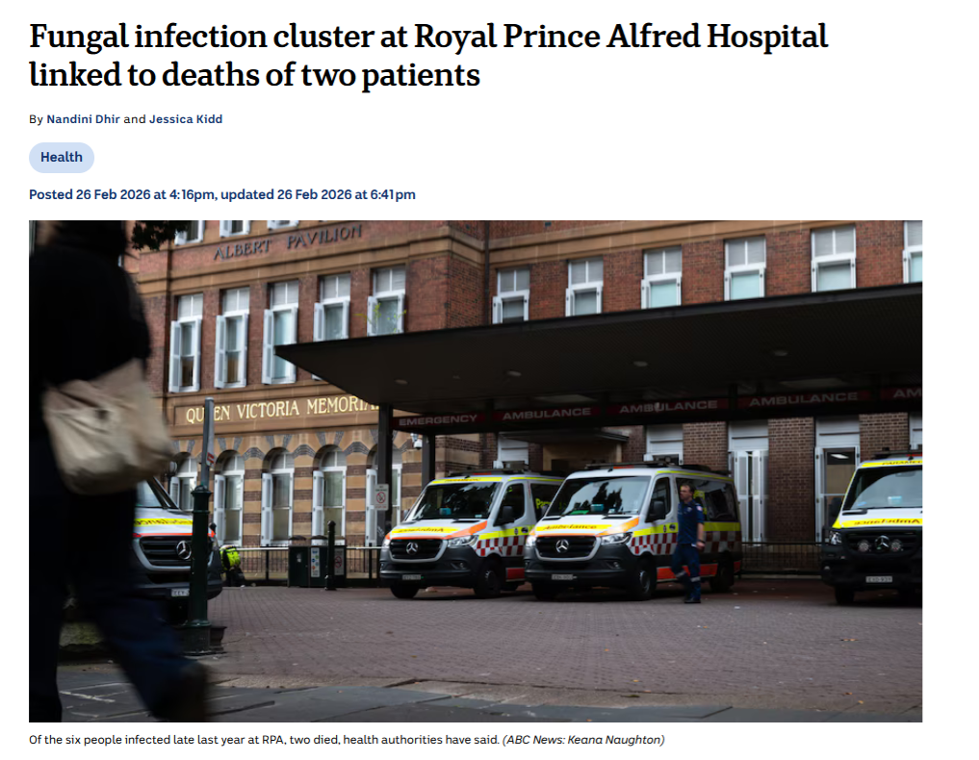
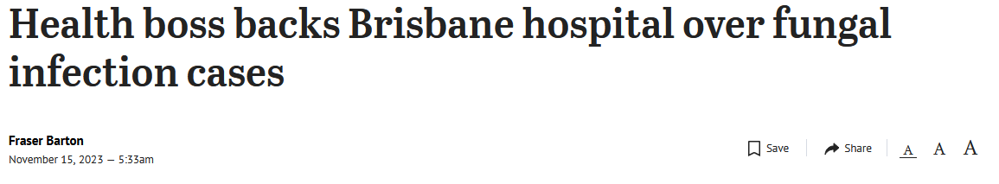
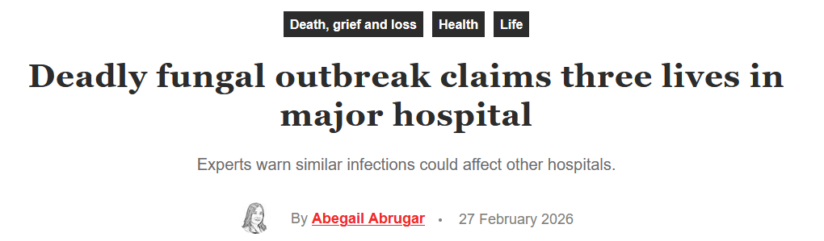

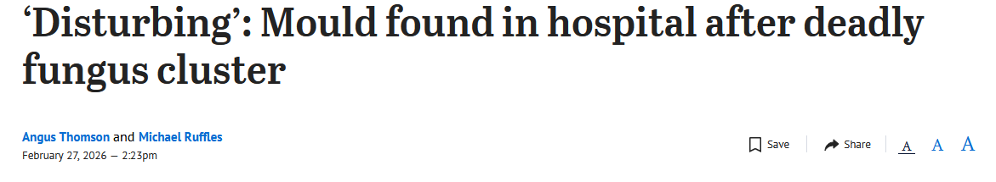
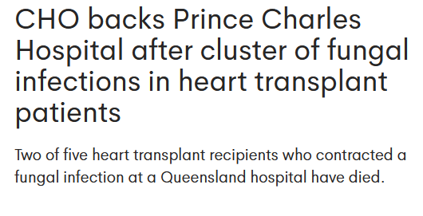

Slide 3
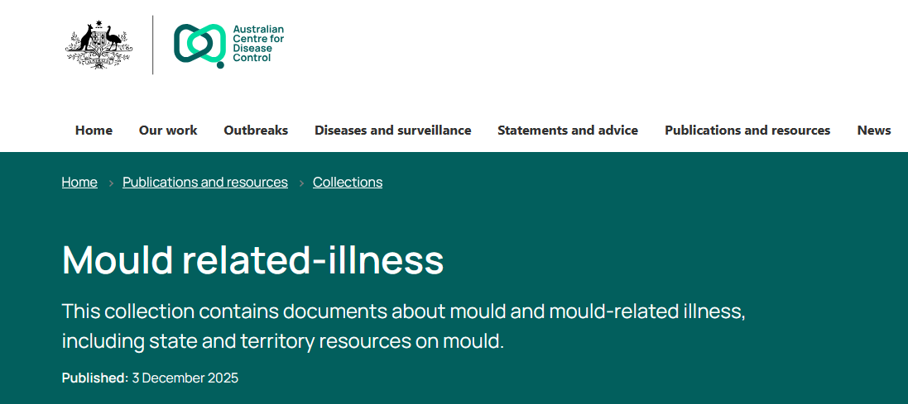




Slide 4
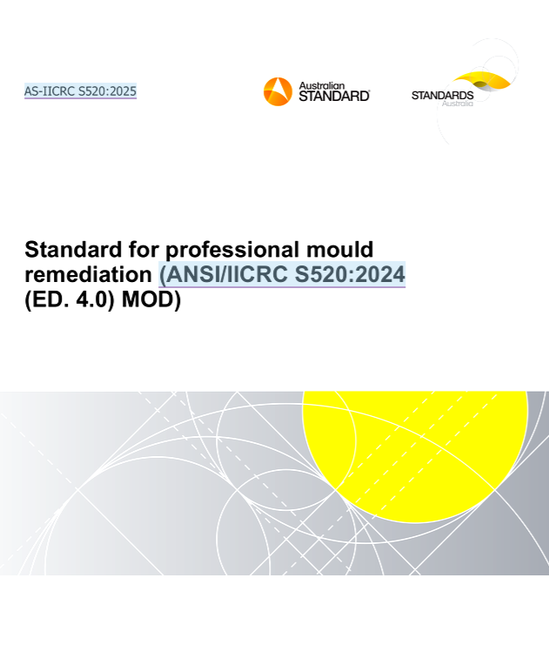
Irony???

Slide 5
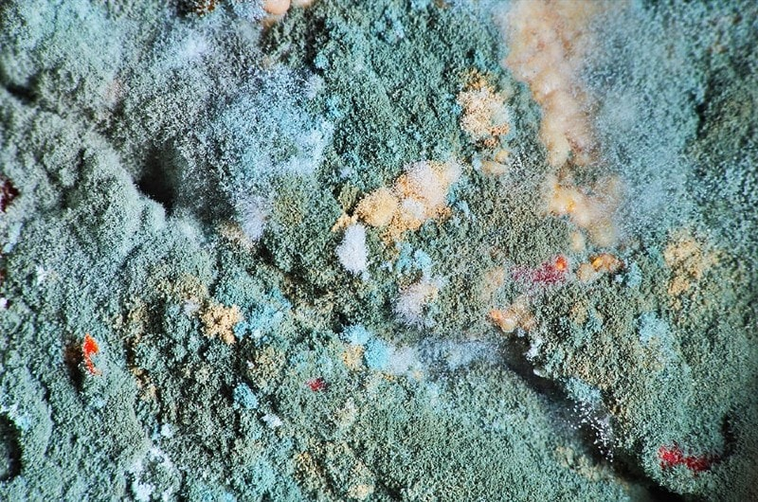
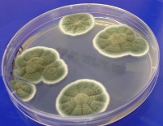
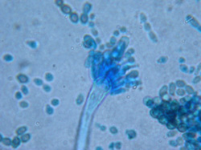
Biology of Mould
Mould (Mold) belongs to the fungal kingdom
distinct from plants and animals, and has been present on Earth for millions of years
Its cells contain a nucleus and organelles like mitochondria, but its outer walls are made of chitin, giving it structural resilience
Requires moisture and food source (cellulose) to grow and doesn’t like disturbance
The basic unit of mould is the hypha, a thin filament that forms a tangled mat called a mycelium, reproduce by spore release
Is ubiquitous and opportunistic when environmental conditions are favourable

Slide 6
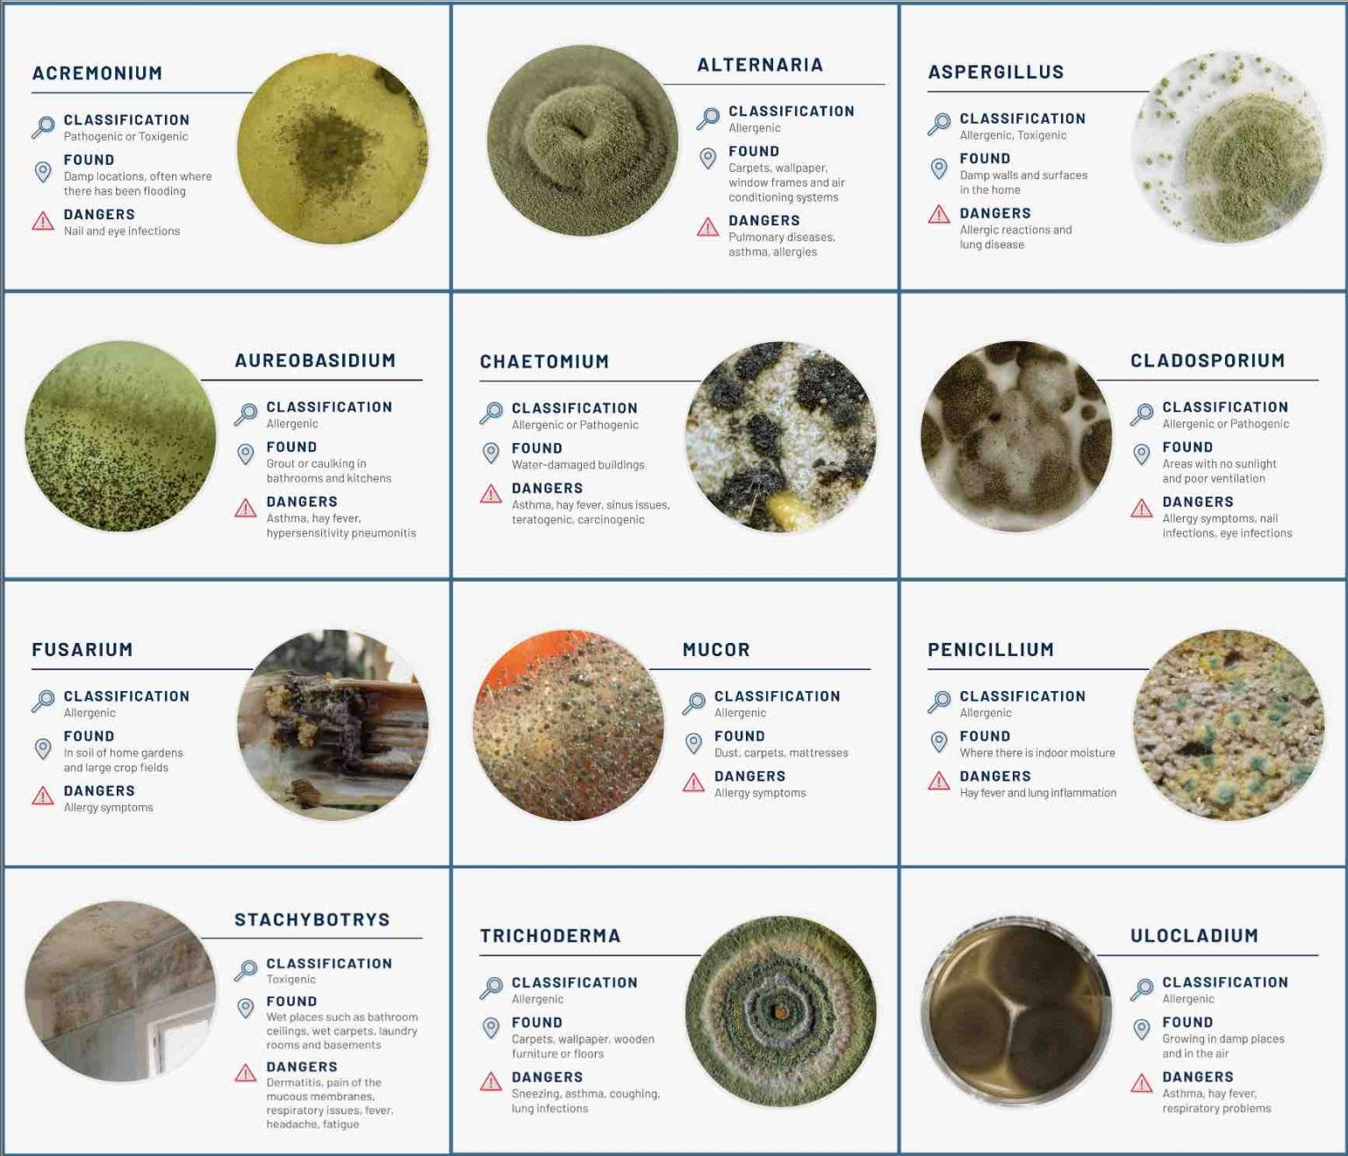
Common Acute Health Effects
Exposure to mould can lead to:
allergic reactions, red eyes and eye irritation
skin rashes and infections
throat irritation
coughing, wheezing, and asthma attacks
hypersensitivity pneumonitis, an immune-mediated lung condition
Severe and Long-Term Effects
Certain moulds produce mycotoxins, which can be toxic if ingested or inhaled over time and include symptons:
immune system changes, inflammation, and cognitive issues such as memory loss, dizziness, and “brain fog”
Some mycotoxins, like aflatoxin, are recognized as carcinogenic (NIEHS)
Death in some cases
Populations at Higher Risk
Children, People with allergies or asthma, Immunocompromised individuals are at higher risk for infections and systemic mycoses

Slide 7
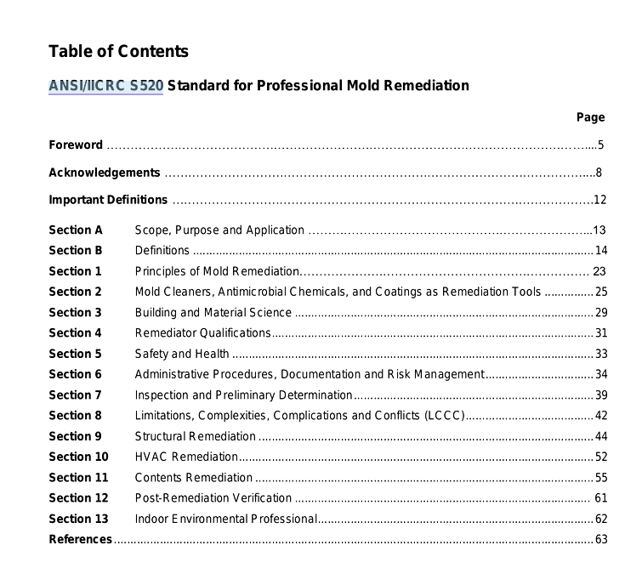

Slide 8
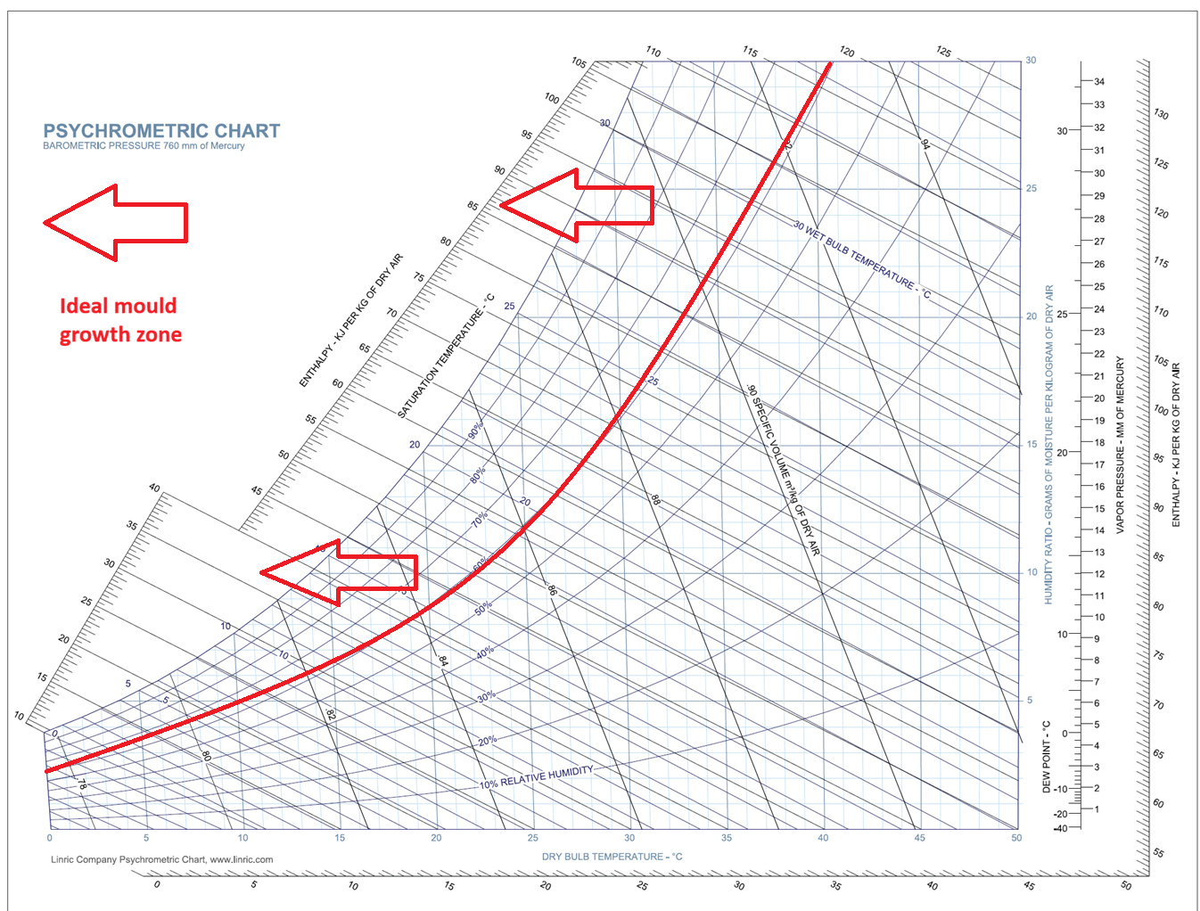
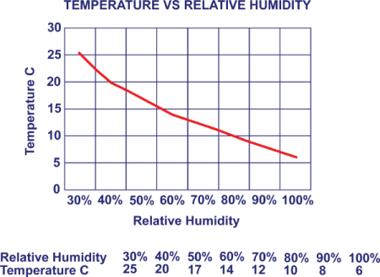
Ideal mould growth conditions
Above 60% relative humidity at any temperature
Above 15% EMC (electronic moisture content – Douglas Fir Scale) in porous materials (plaster, cardboard, timber)

Slide 9
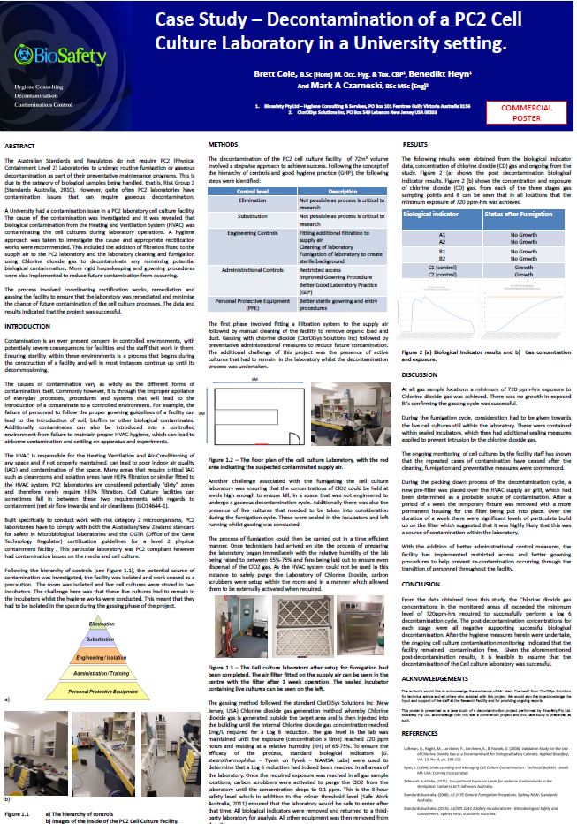
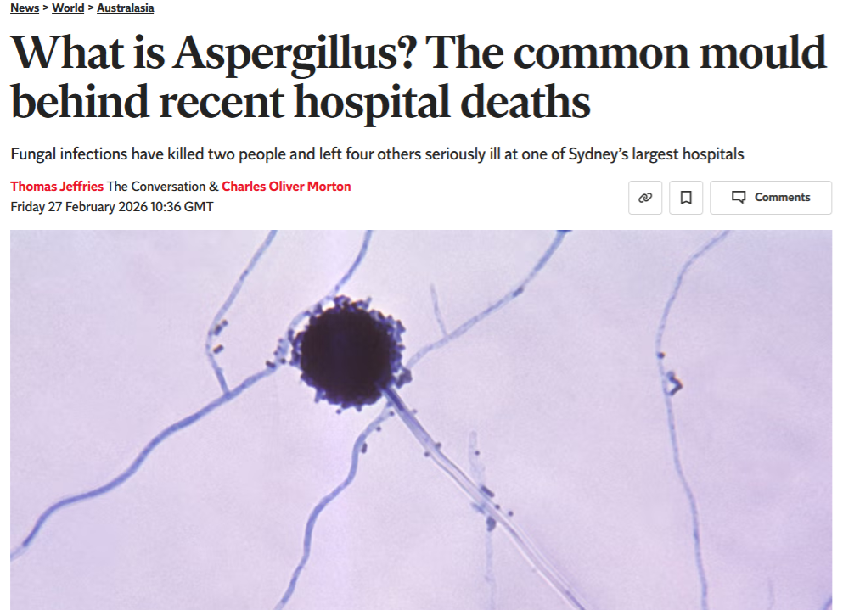
2016 - 2026

Slide 10
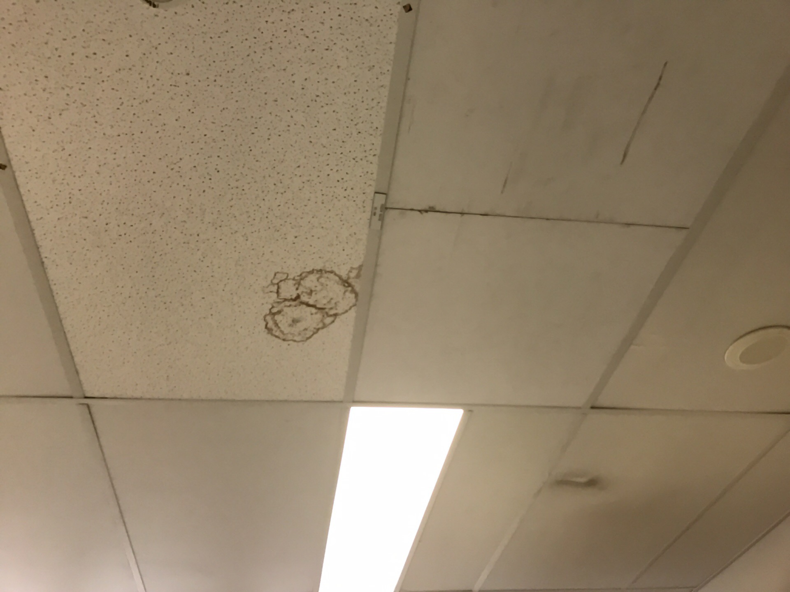
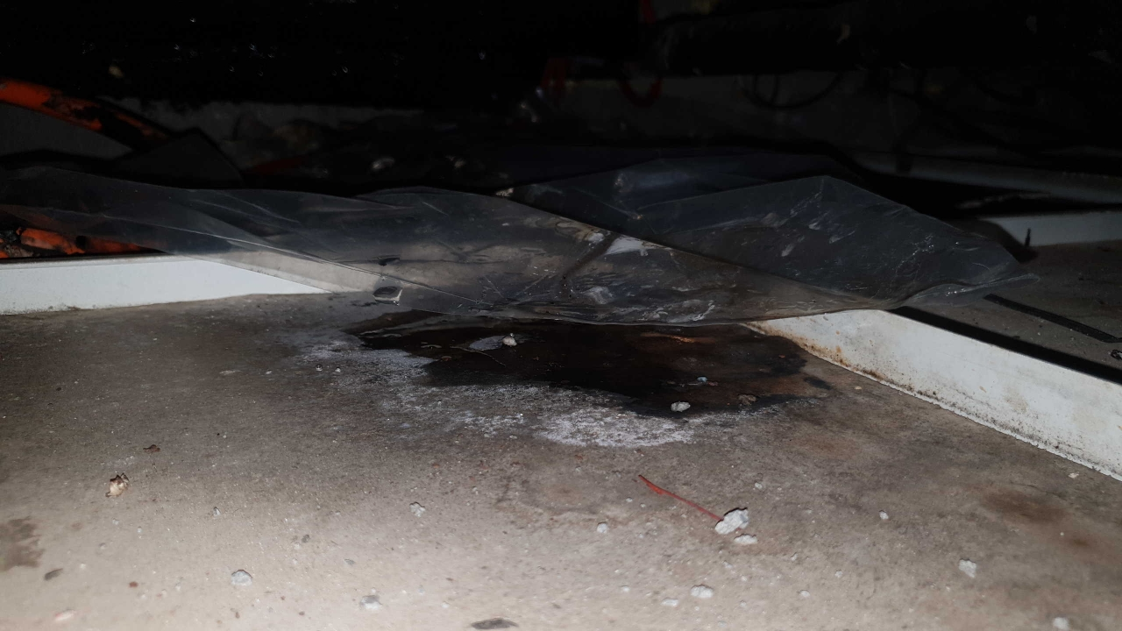
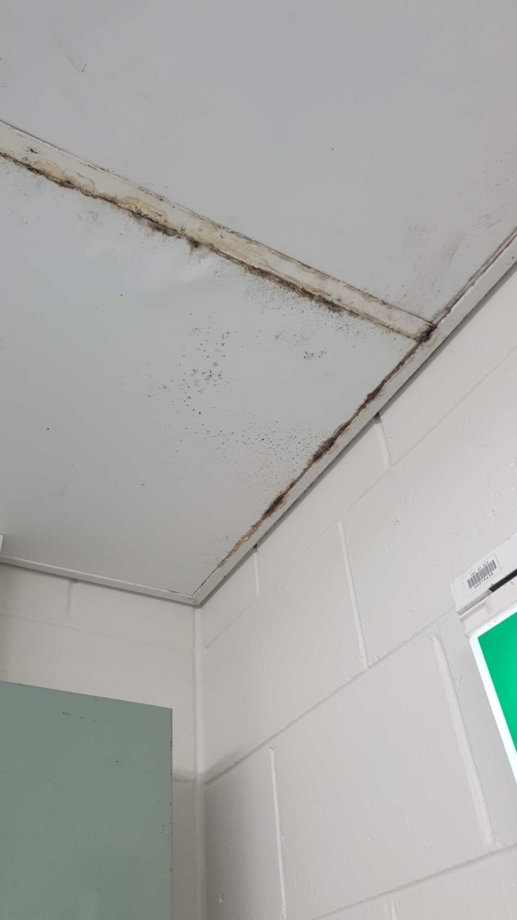
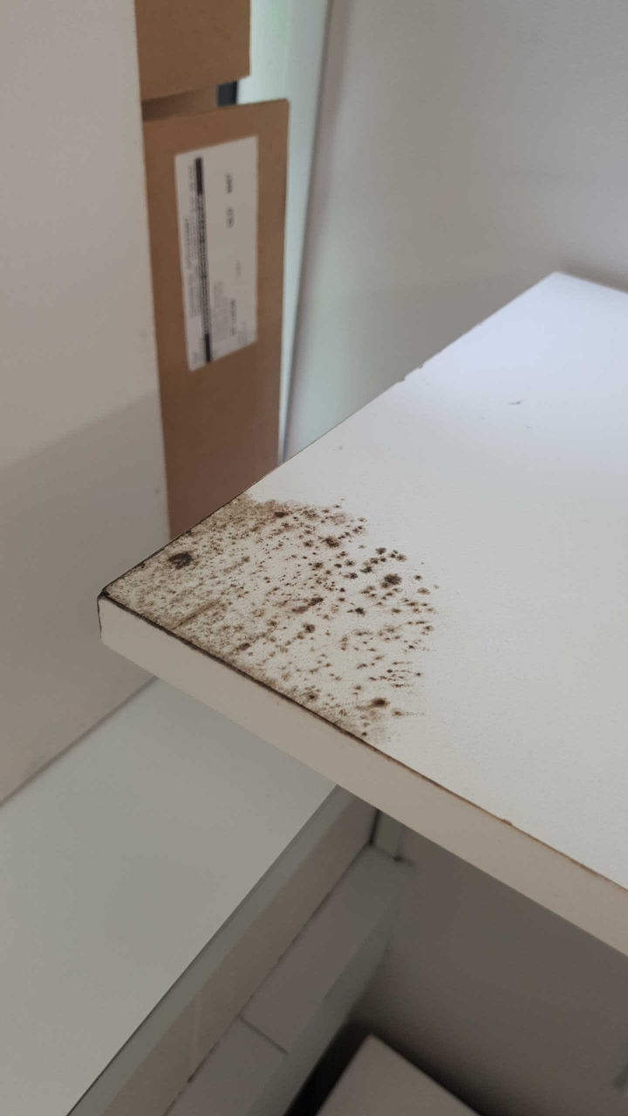
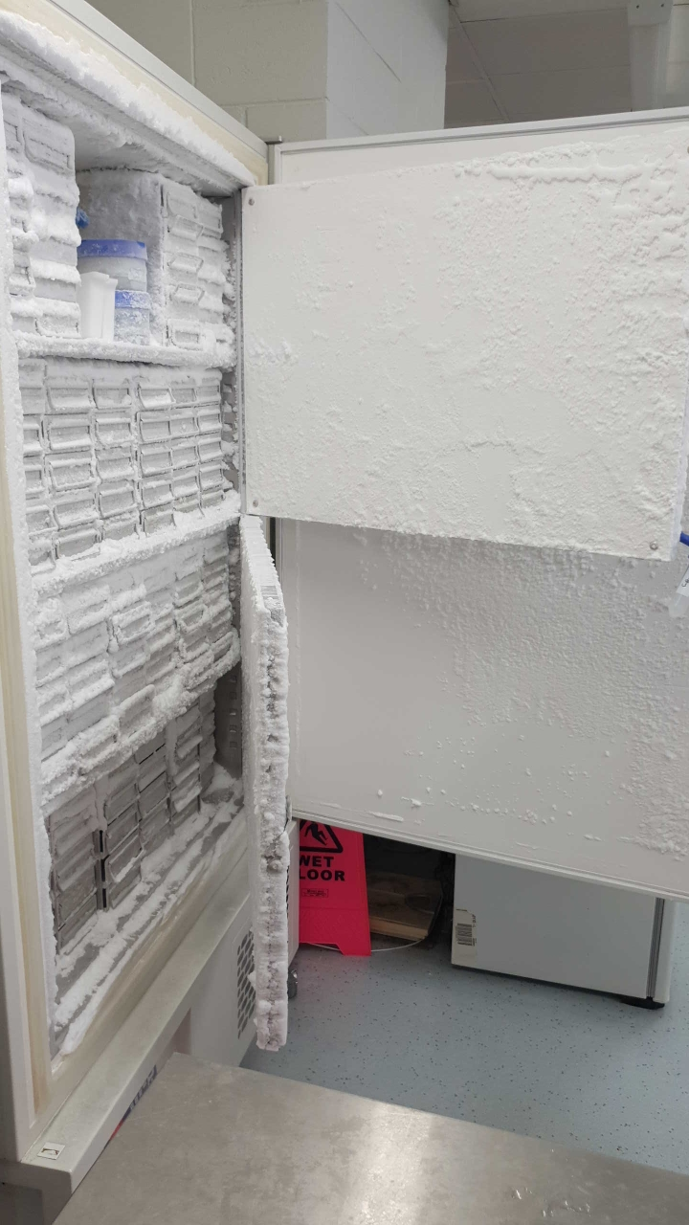
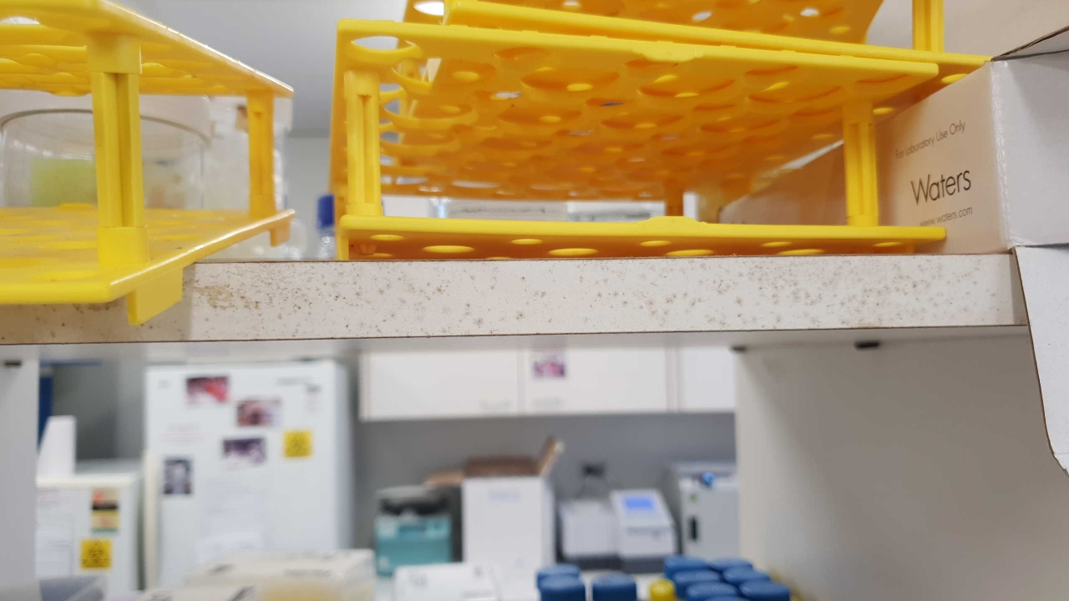

Slide 11
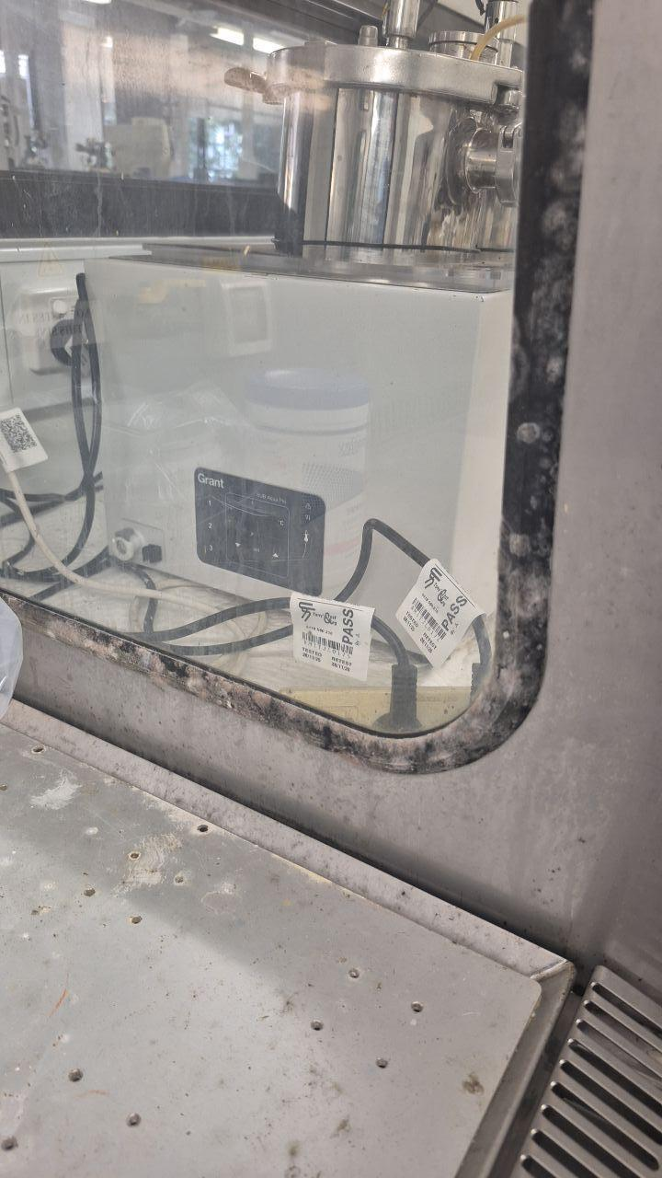
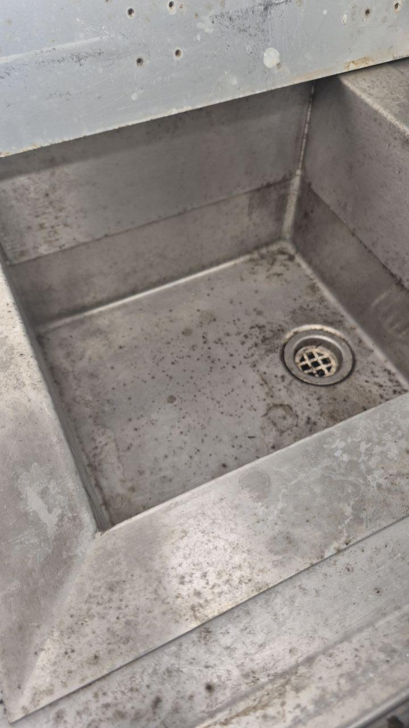
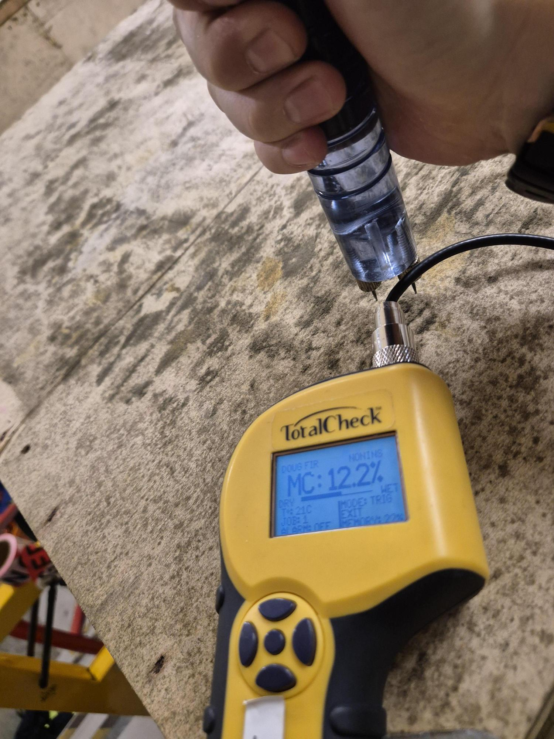

Slide 12
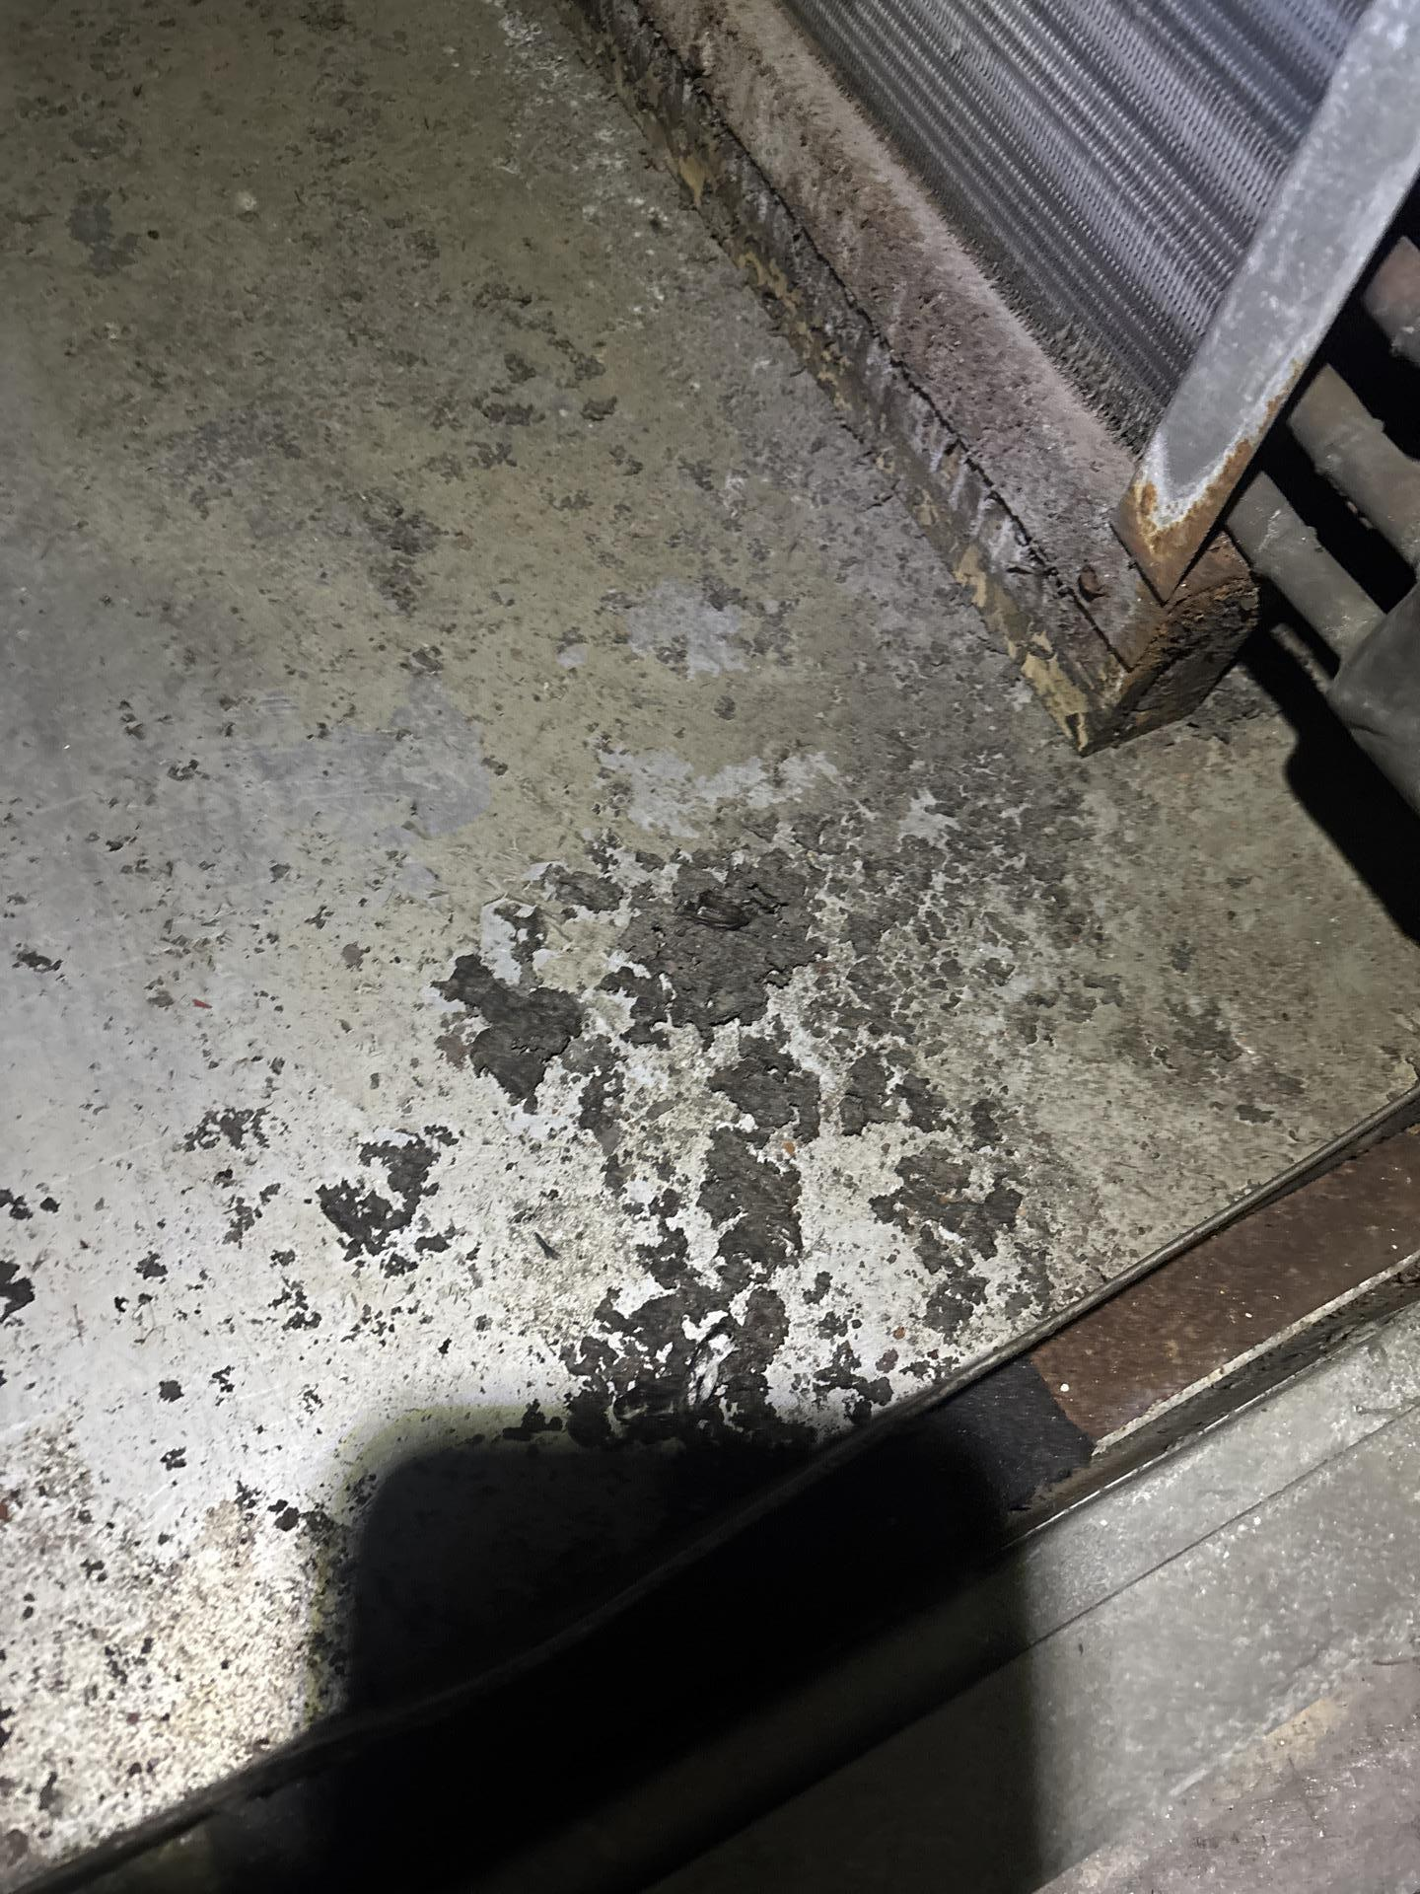
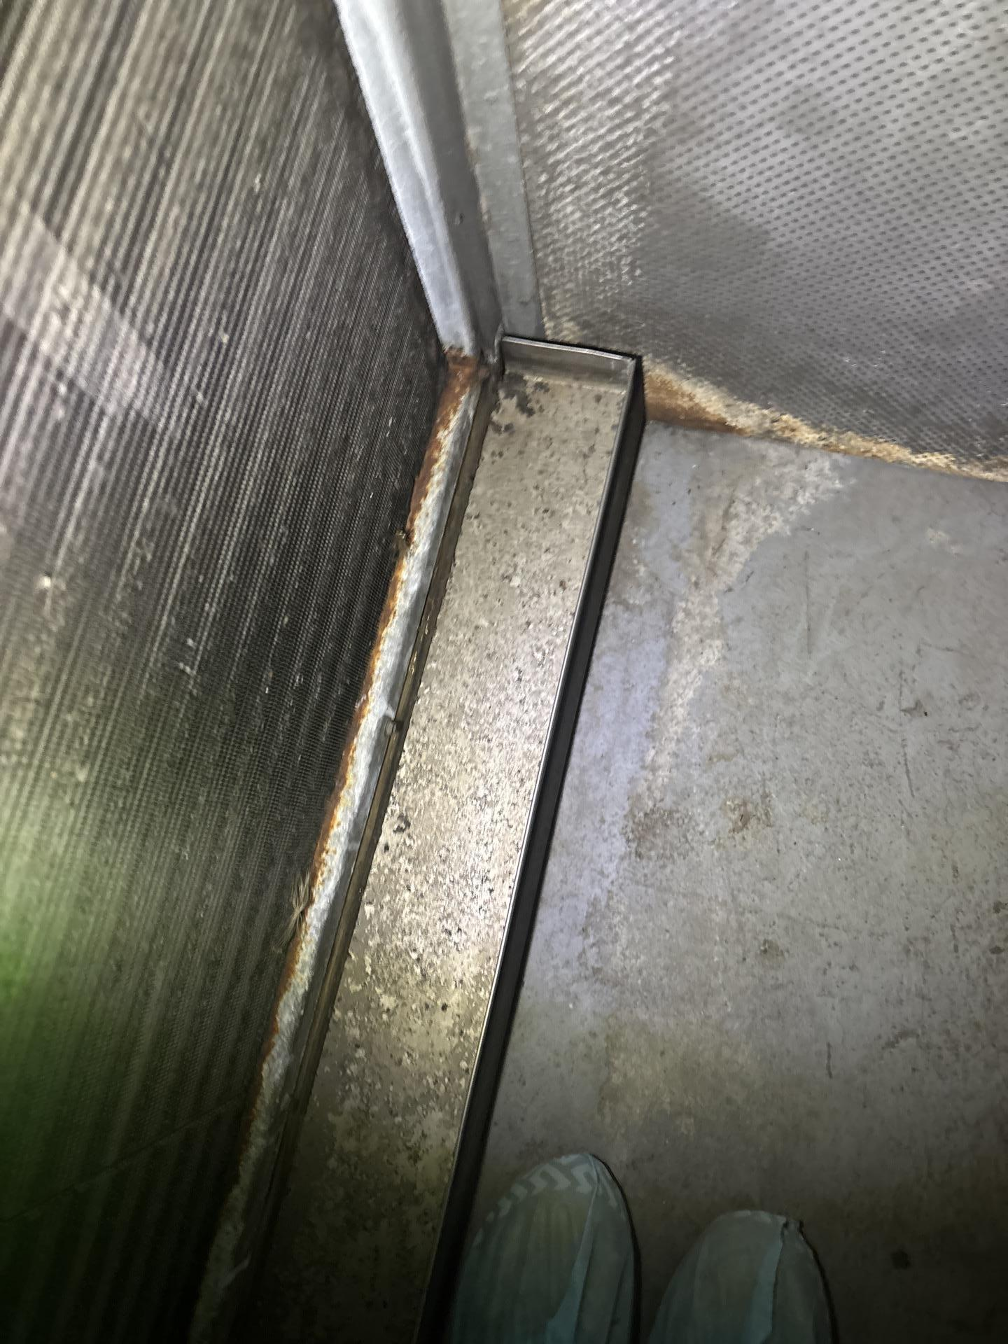
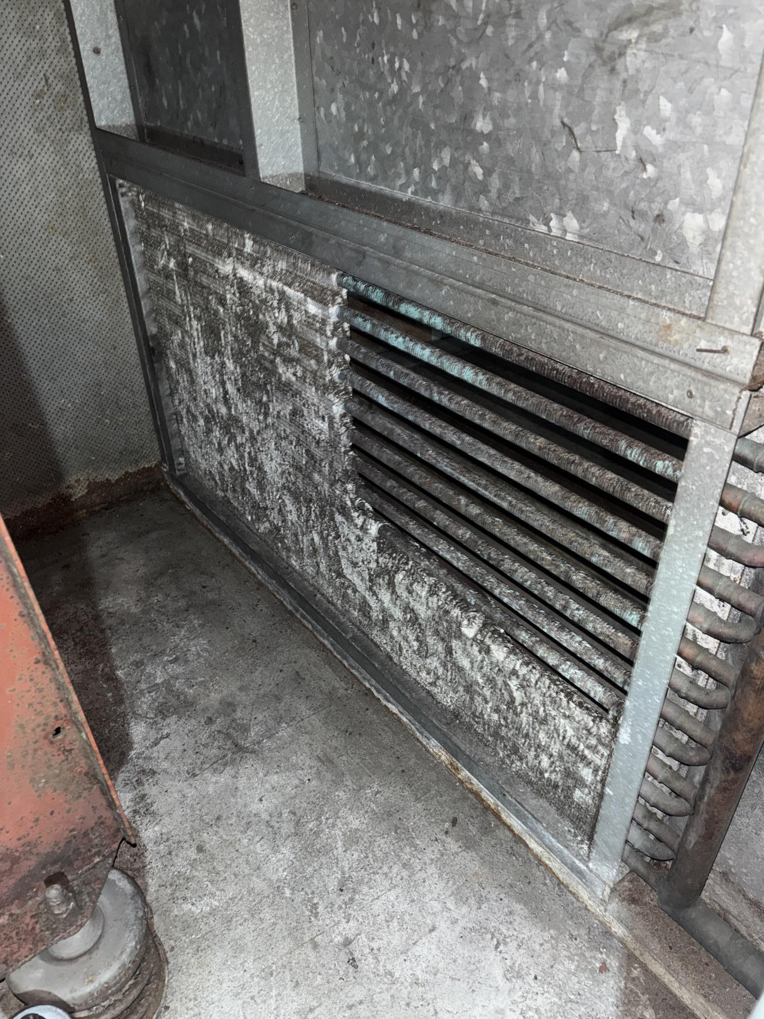
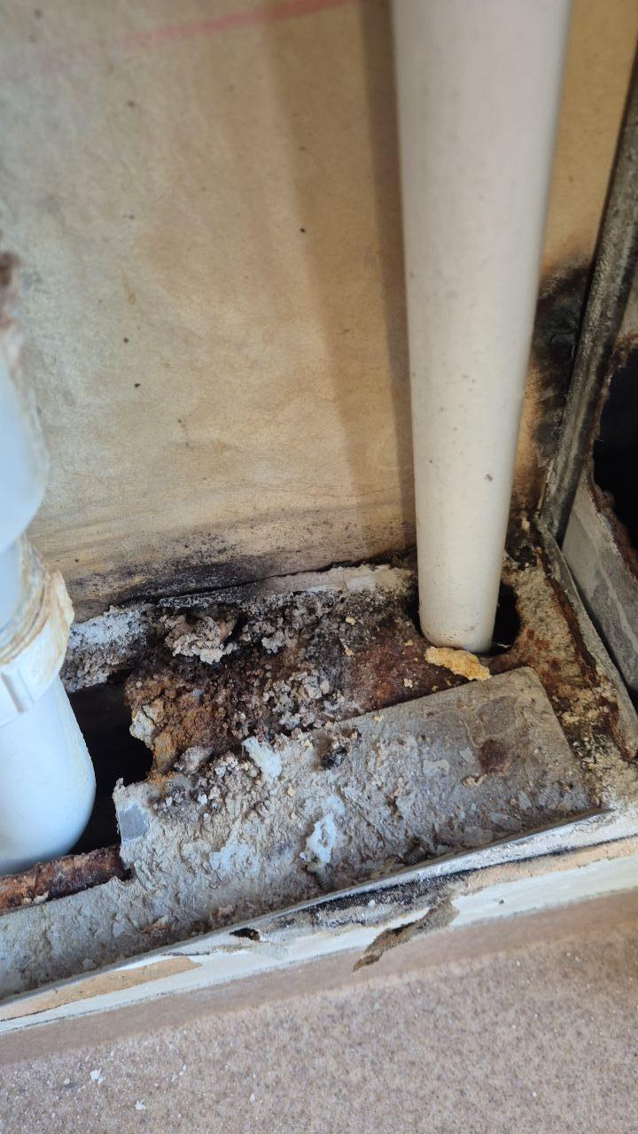
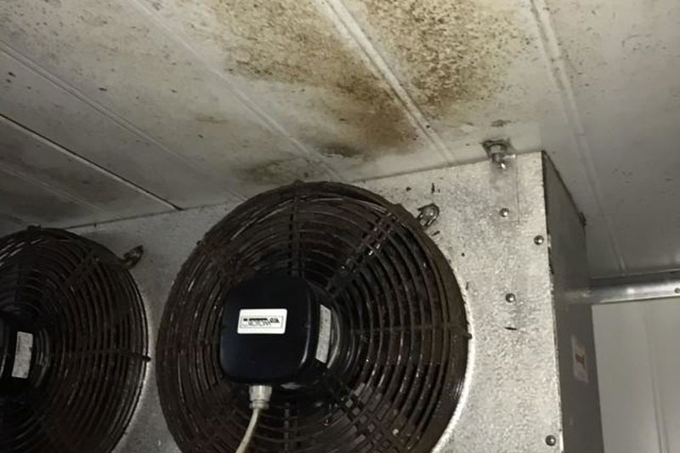
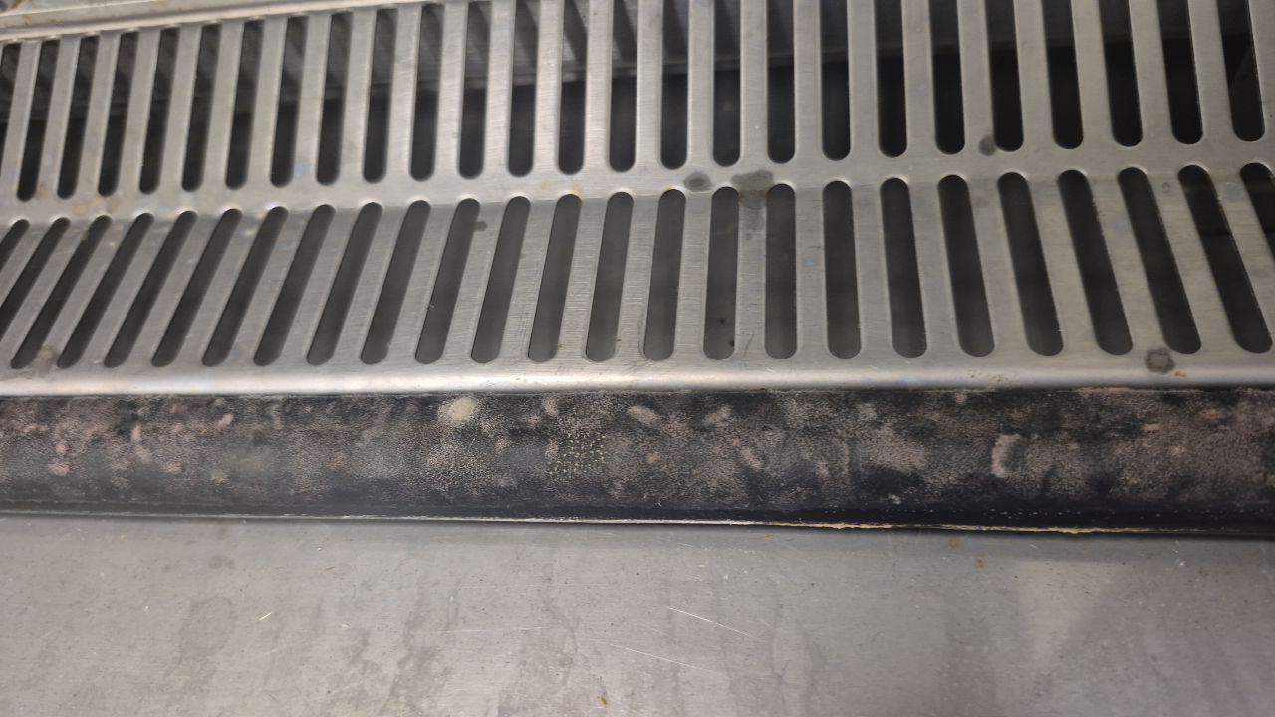

Slide 13
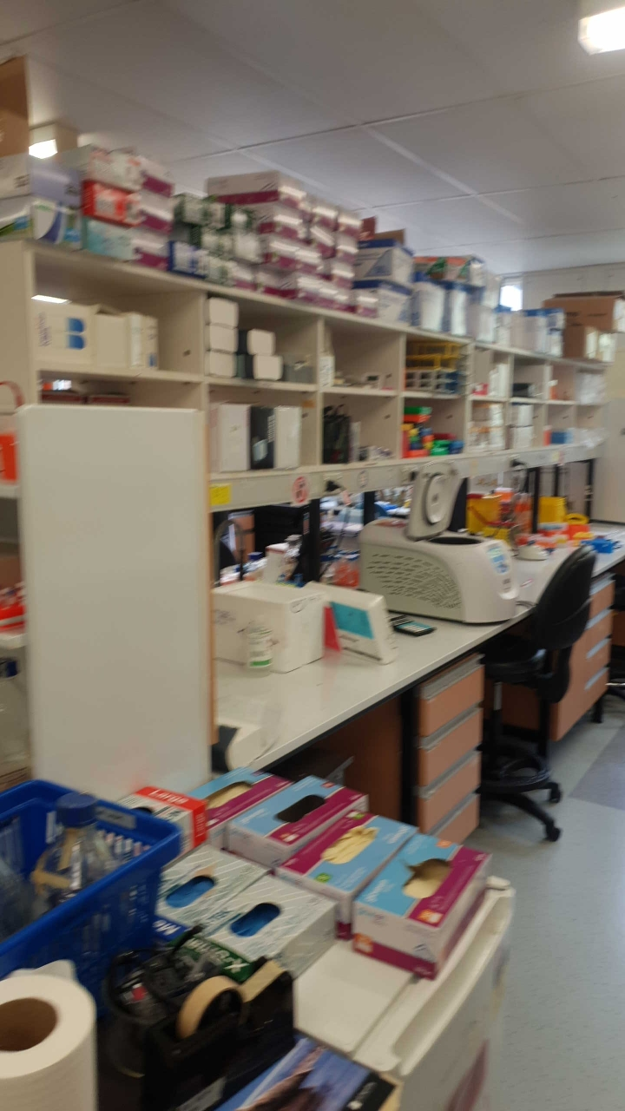
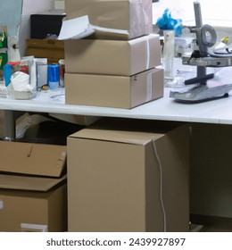
WHY DO LABORATORIES HAVE MOULD ISSUES:
HVAC design being overused in terms of heat load
More heat generating equipment (incubators, -80ºC freezers etc) than design allows
Poor ventilation and filtration
Too much equipment in labs affecting airflow
Inventory control in cool rooms
Too much porous material
Not enough routine cleaning
Poor ingress hygiene
Lack of awareness
Lack of care – everybody knows, somebody complains, nobody does anything!!!

Slide 14
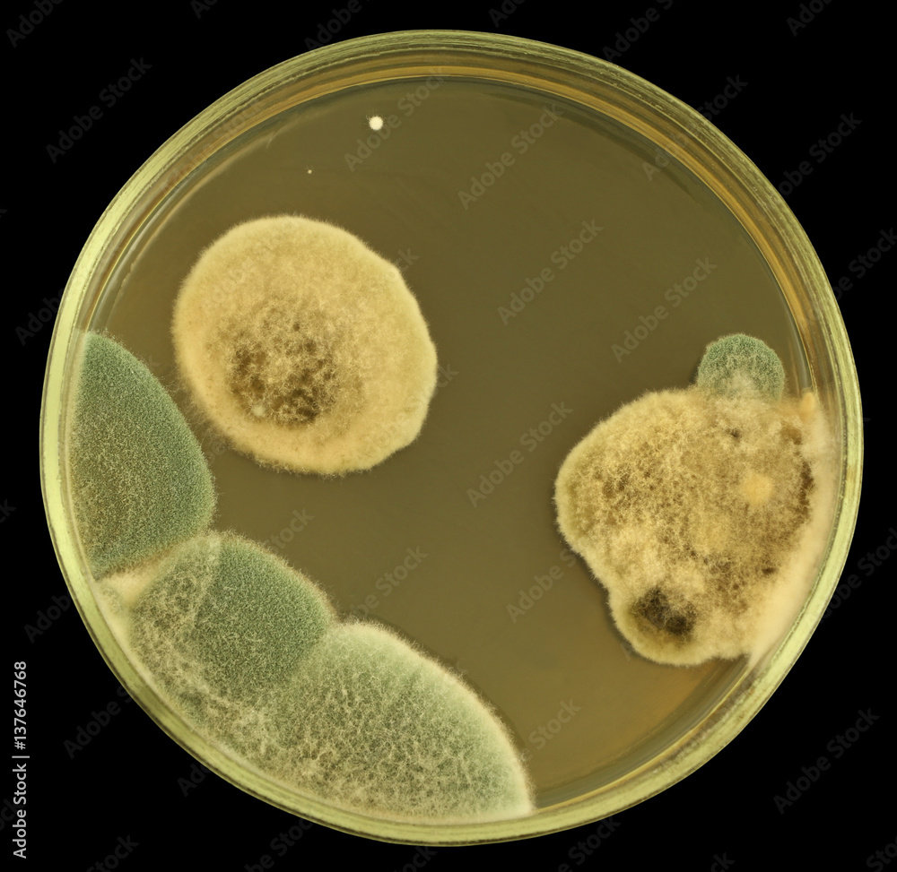
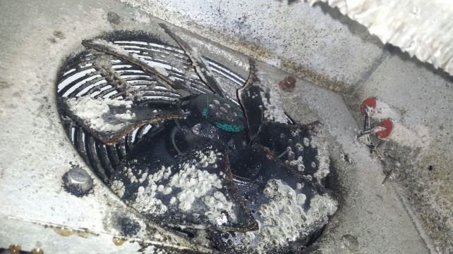
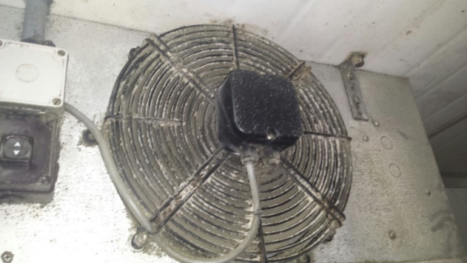
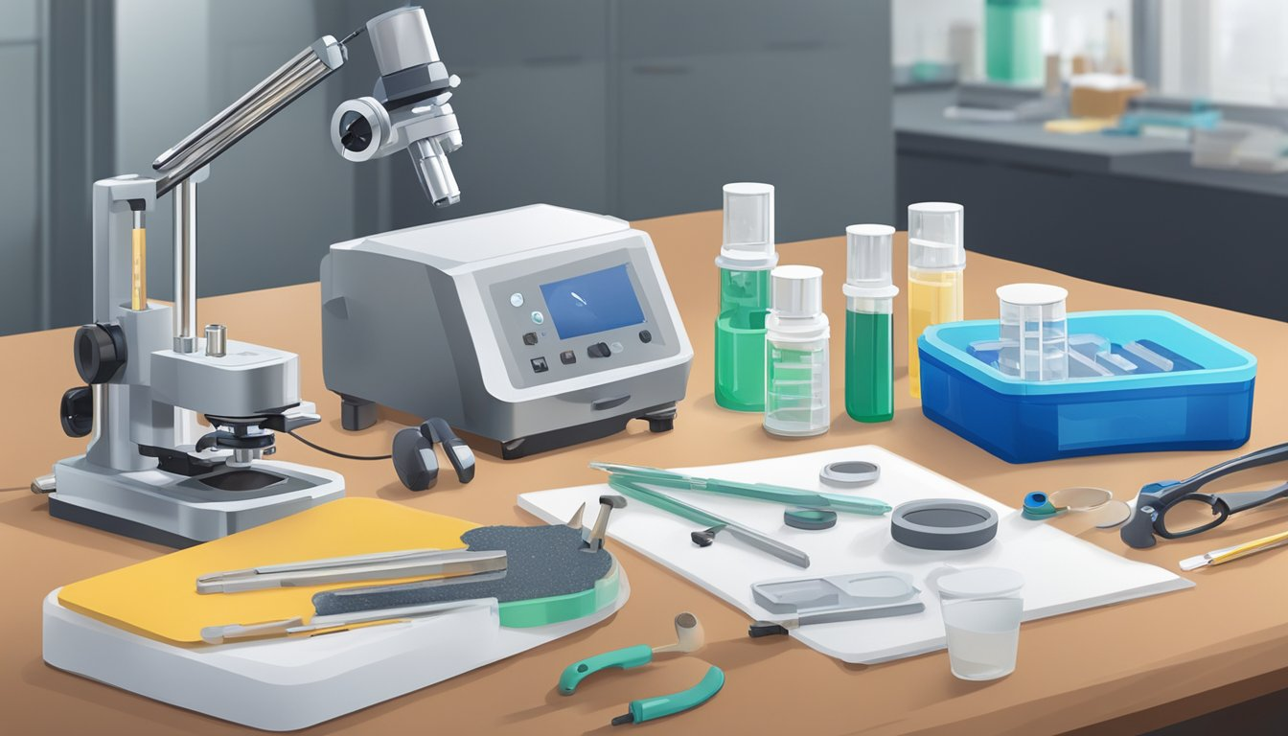
WHAT ISSUES DO LABORATORIES EXPERIENCE FROM MOULD:
Staff exposure potential
Health affects
Cross contamination of stored samples
Compromised cultures
Compromised sterile consumables
Spore contamination in cool rooms, incubators, clean work benches etc
Odour and unsightly staining
Structural and building material damage
Contamination in sensitive diagnostic equipment such as microscopes, PCR machines, Cytometers etc
Feeling of being unsafe

Slide 15
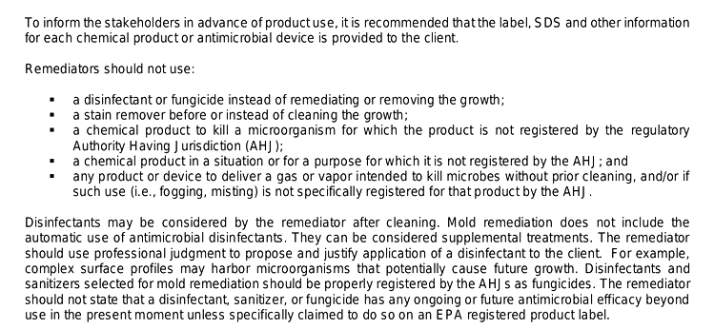
REMEDIATION OF MOULD:

Slide 16
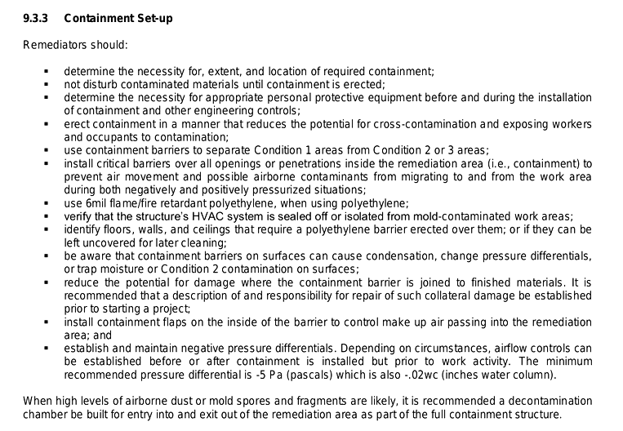
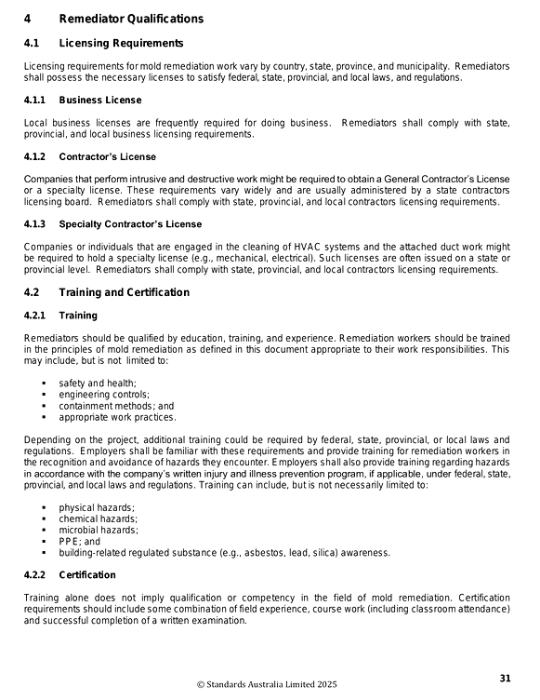
REMEDIATION OF MOULD:

Slide 17
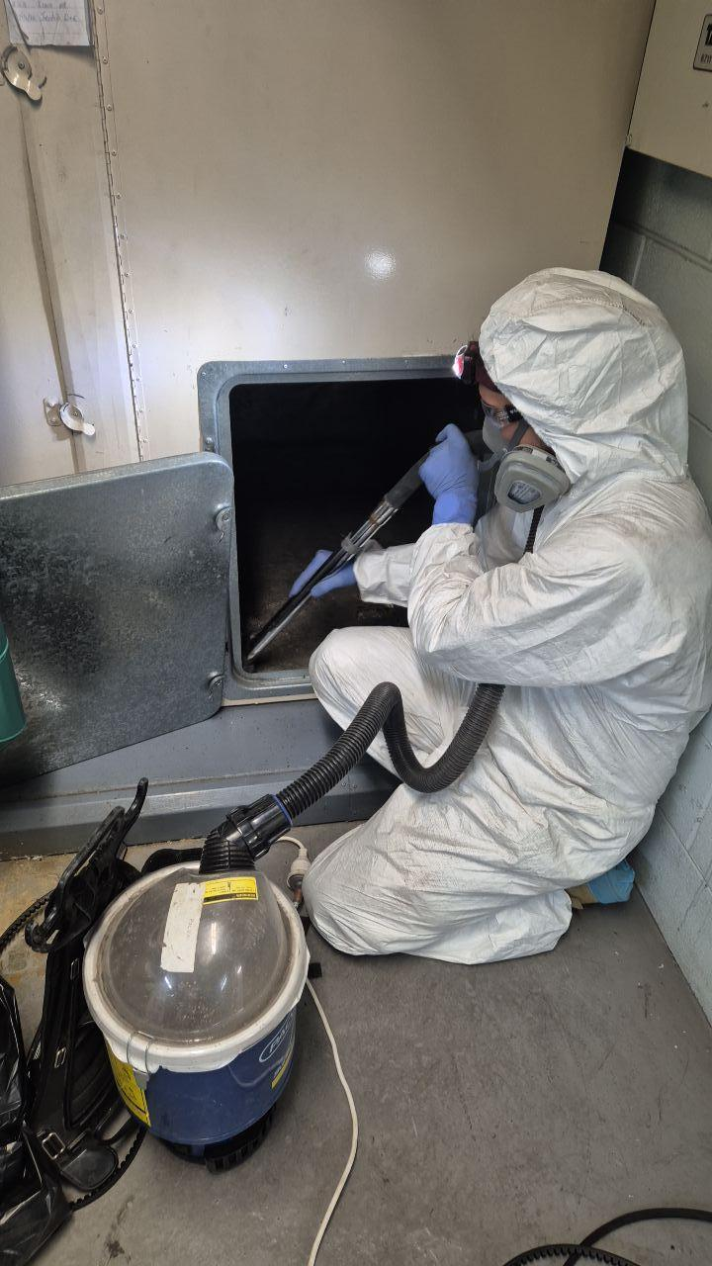
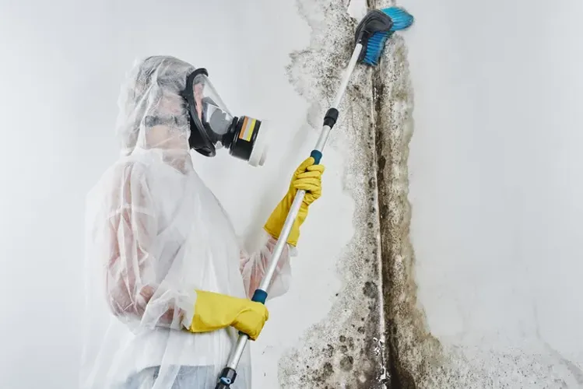
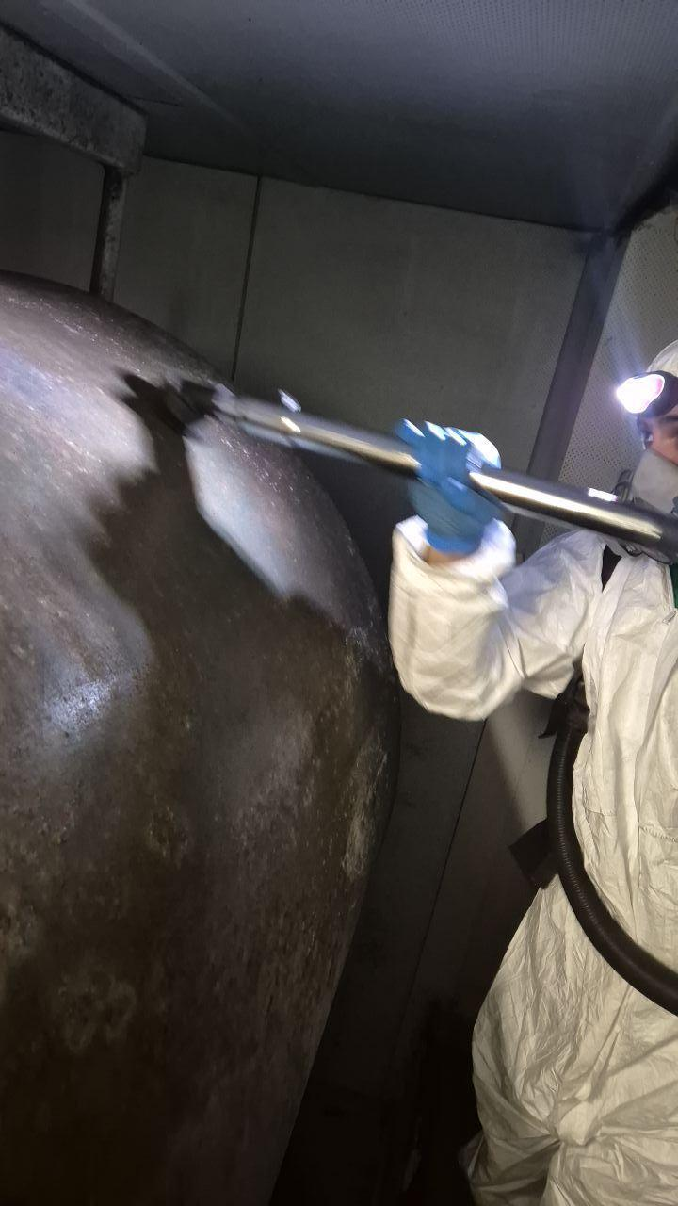
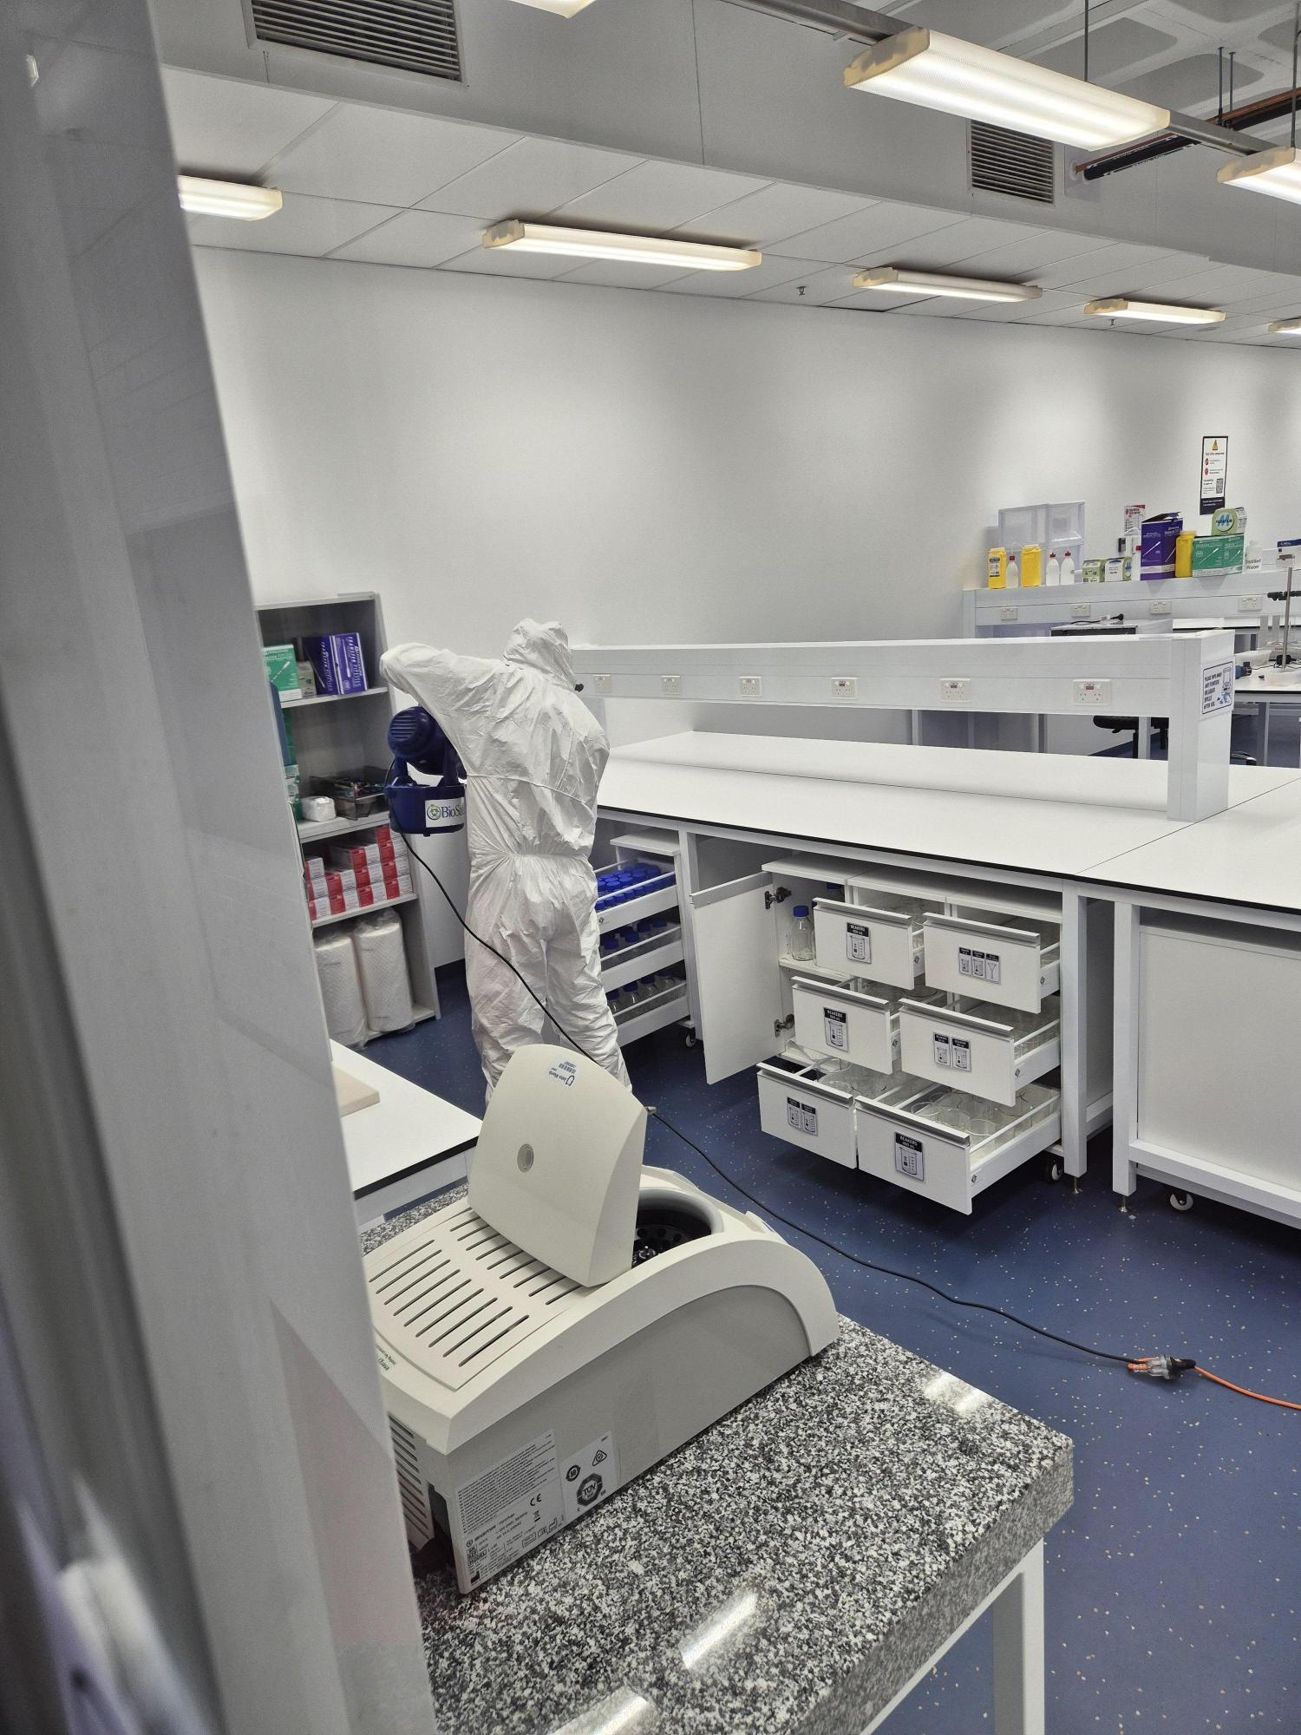

REMEDIATION OF MOULD:
THE HEPA SANDWICH

Slide 18
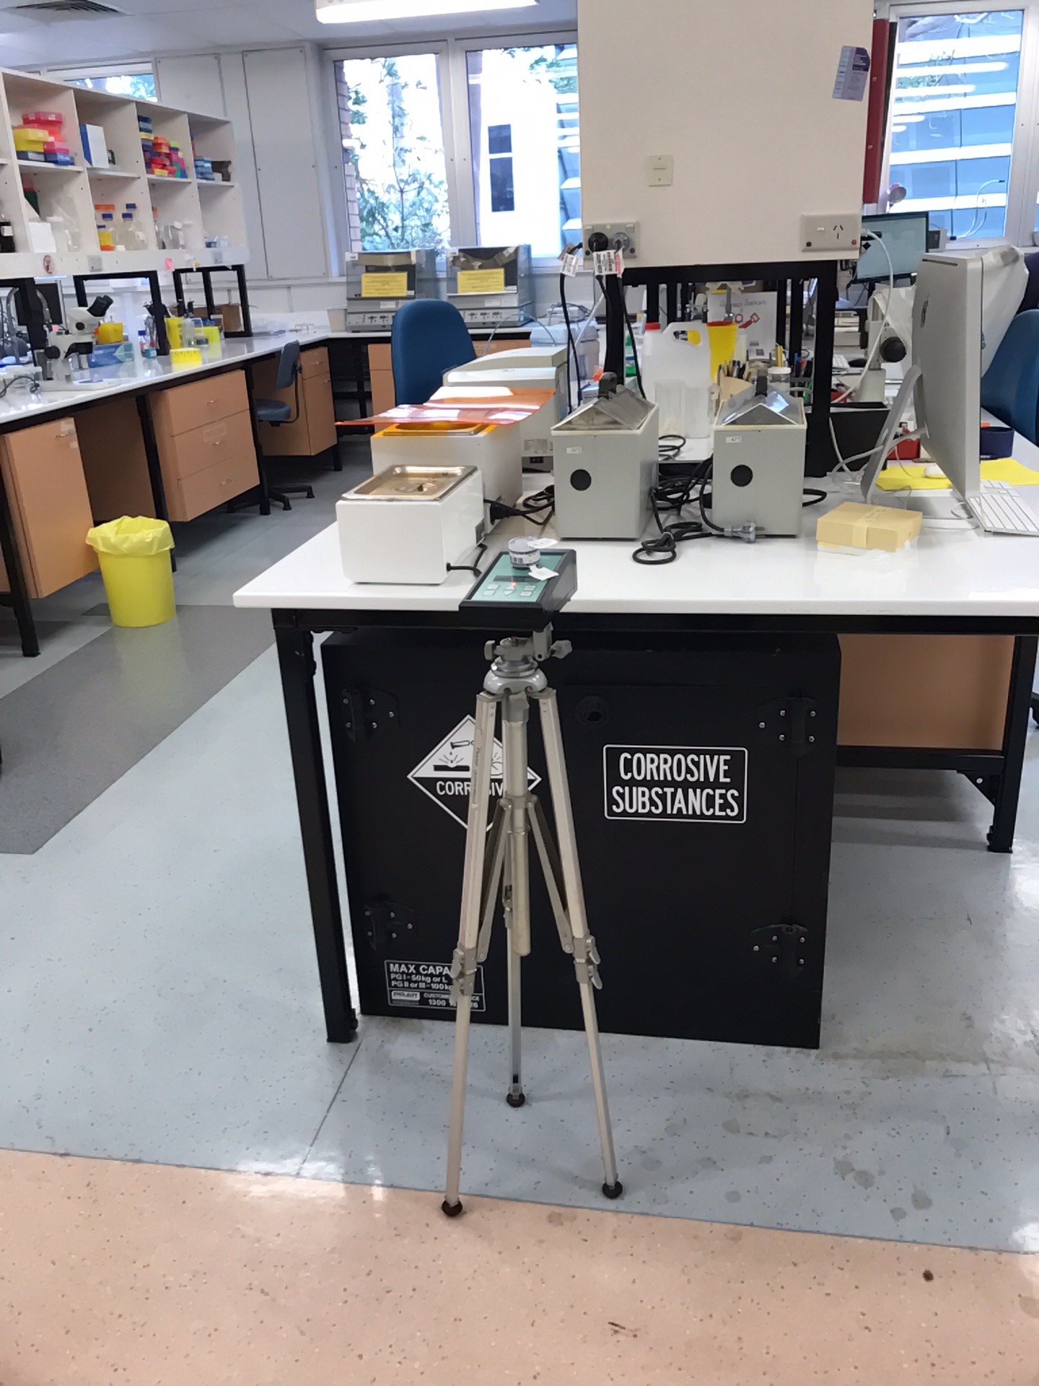
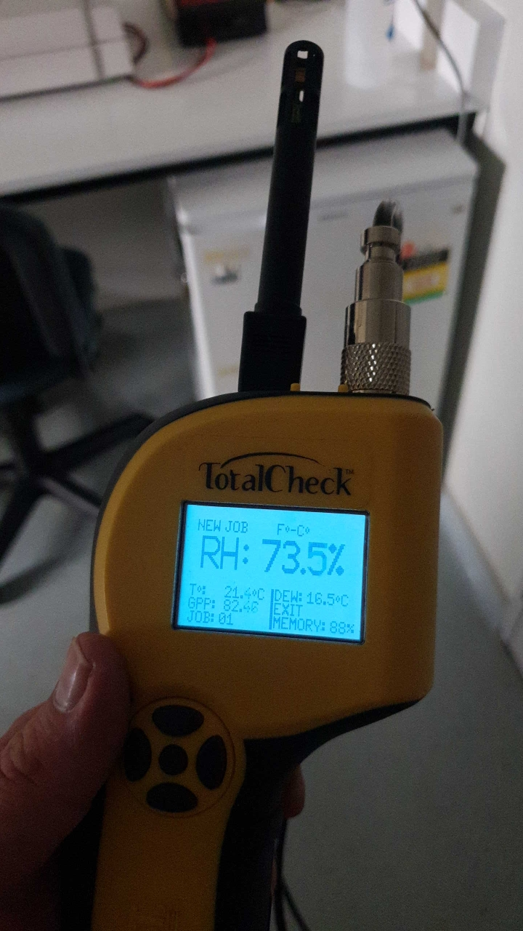
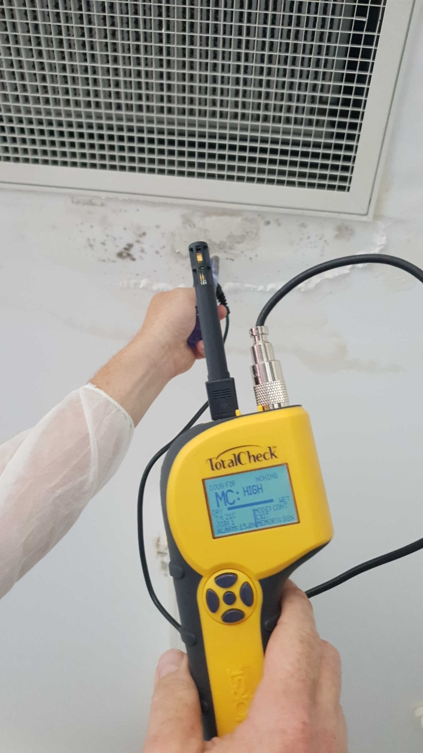
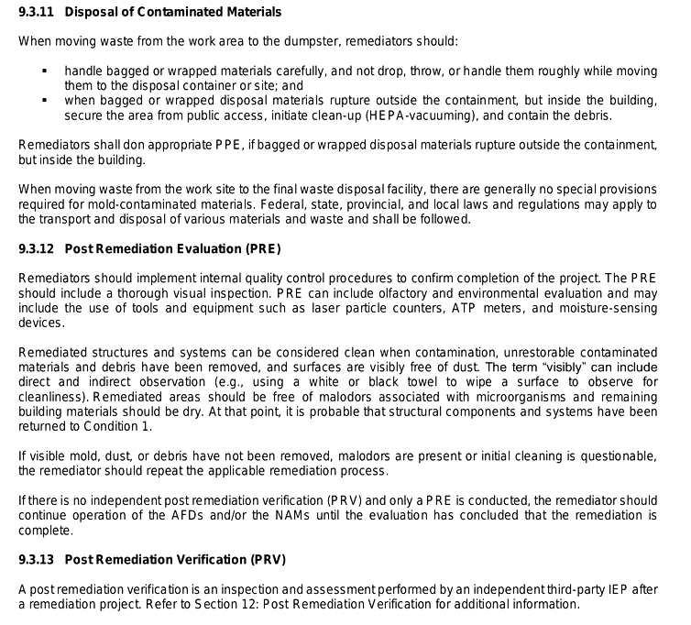
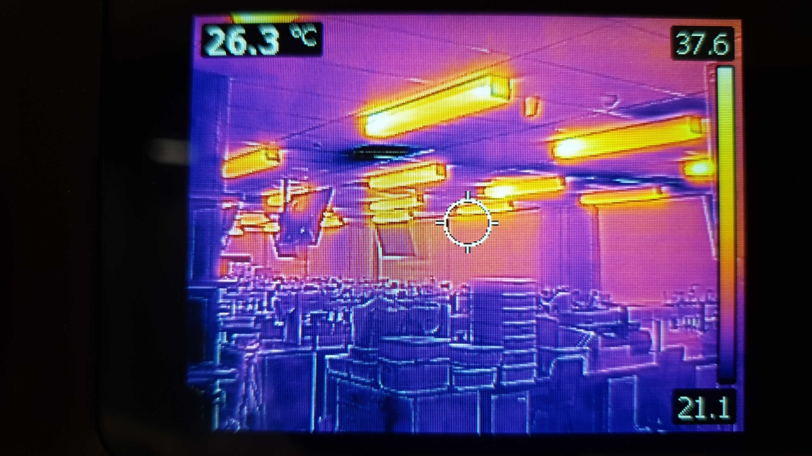
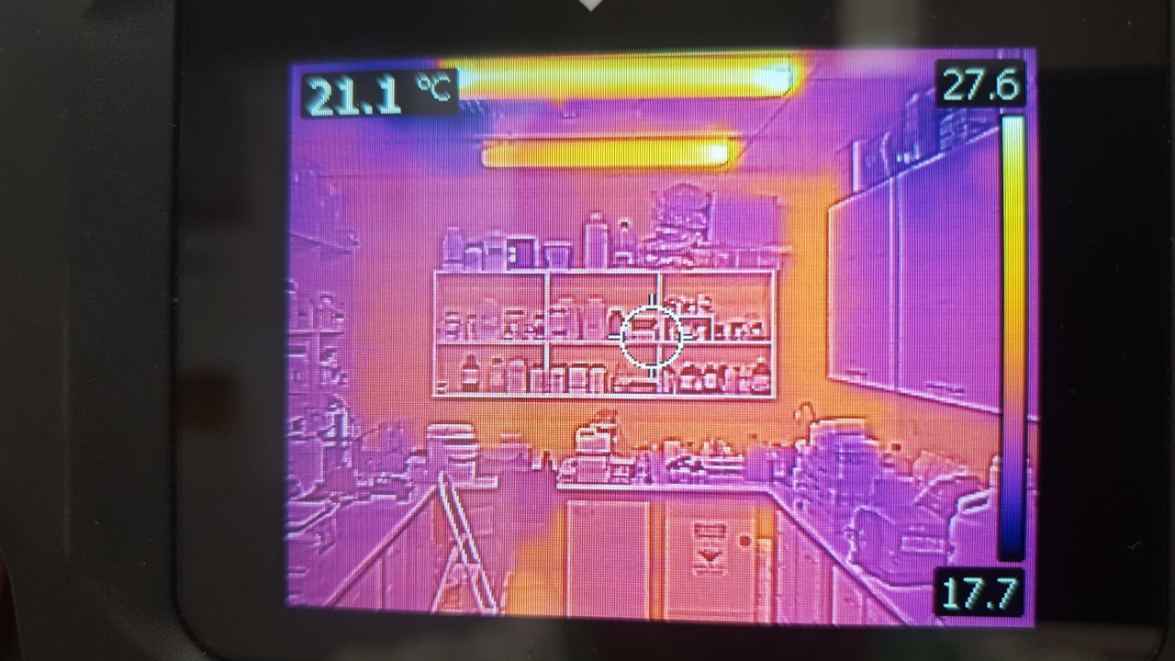
REMEDIATION OF MOULD:

Slide 19



HOW DO LABORATORIES STOP MOULD:
The key to stopping mould growth:
controlling moisture
improving ventilation
good laboratory housekeeping
cleaning affected areas promptly and safely
avoid porous material in labs and cool rooms
Don’t overload lab storage and affect ventilation
Ingress hygiene control (~80% contamination comes via people)
Good mould stewardship and laboratory practices

Slide 20





Case Study: Clinical Cell Culture Laboratory with Mould Contamination caused by Mould biofilm in the ceiling space:

Slide 21




NOT ALL YEAST & MOULD IS BAD!!!
(In moderation of course ☺)
14th Annual ABSANZ Conference – 2026
Thank You
Questions?
Brett Cole
Email: brett@biosafety.com.au
Website: www.biosafety.com.au

